Slide 1
Dementia Friendly America:
An Overview

Slide 2
Dementia Friendly America
Dementia Friendly America (DFA) launched at 2015 White House Conference on Aging
Our goal is to catalyze a movement to more effectively support those living with dementia and their care partners
Modelled after Minnesota’s ACT on Alzheimer’s
Dementia Friends is a program within Dementia Friendly America that focuses on individual-level impact
National Association of Area Agencies on Aging is fiscal agent and program administrator for DFA.
www.dfamerica.org and www.dementiafriendsusa.org

Slide 3
Sample of DFA National Participants
AARP
ACT on Alzheimer’s
Administration on Community Living (Federal Liaison)
Advocates living with dementia
Alzheimer’s Association
Banner Health
Blue Cross Blue Shield of Minnesota
BrightFocus Foundation
Banner Health
CDC (Federal Liaison)
CVS Caremark
Connected Living
Dementia Action Alliance
Eli Lilly
Global CEO initiative
Health Resources and Services Administration (Federal Liaison)
Home Instead Senior Care
Individuals living with dementia and care partners
International Association of Chiefs of Police (IACP)
Leaders Engaged on Alzheimer’s Disease (LEAD)
LeadingAge
Otsuka Pharmaceutical Companies
National Alliance for Caregiving
National Asian Pacific Center on Aging
National Association of Area Agencies on Aging (n4a)
National Community Reinvestment Coalition
National League of Cities
National Association of Counties
AMDA – Society for Post-Acute Long-Term Care
Volunteers of America
US Against Alzheimer’s, including Women’s, Clergy, African American, and Latino Networks
Youth Movement Against Alzheimer’s

Slide 4
The Growing Need

Slide 5
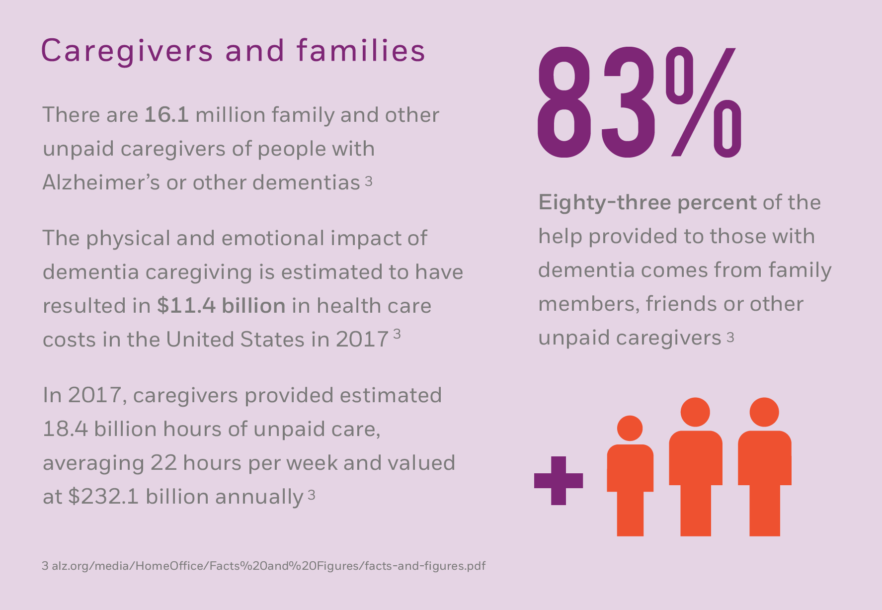
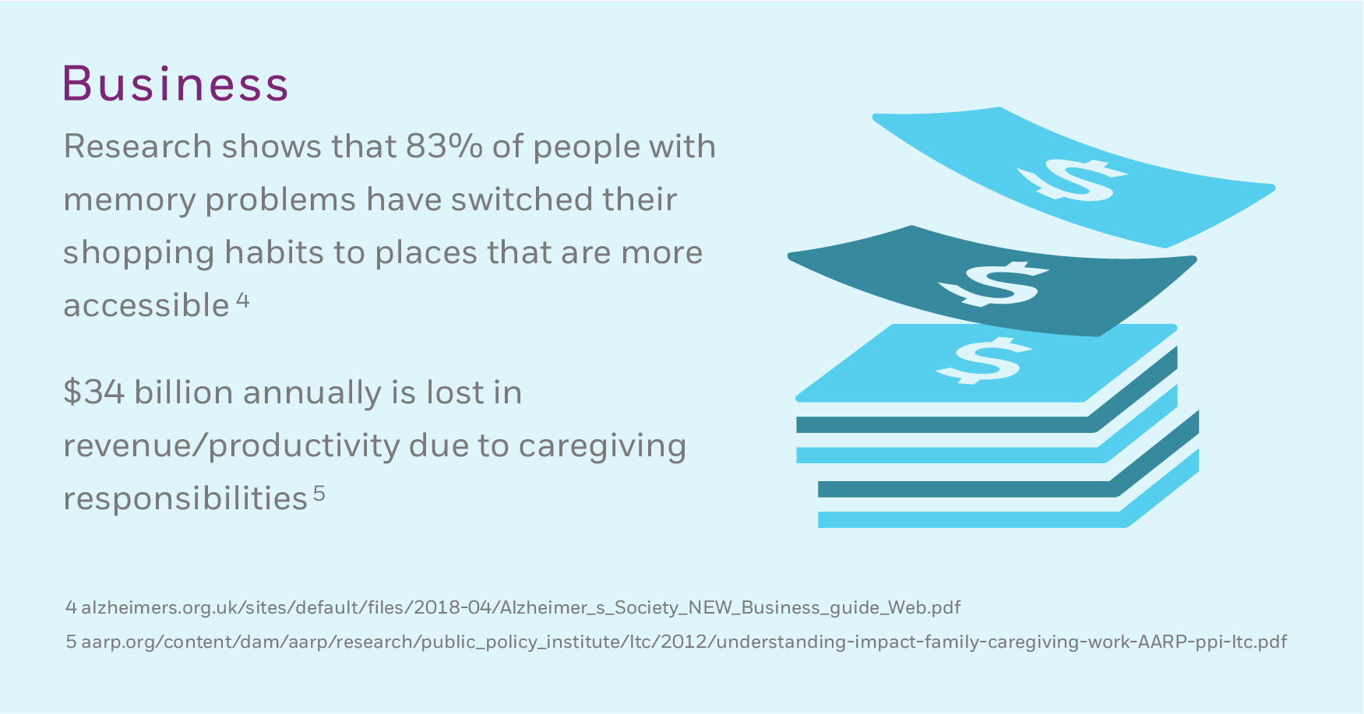
The Growing Need

Slide 6
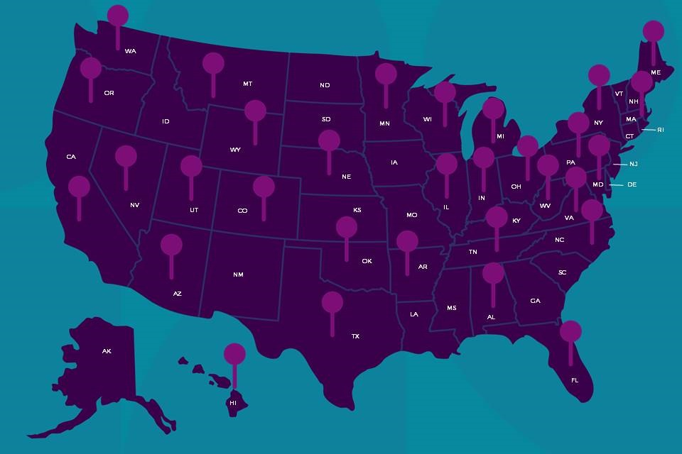
In Communities Across the Country
Goal is to have a DFA community in each state across the country and expand relationships with existing states/ communities.

Slide 7
What is a Dementia Friendly Community
A dementia friendly community is informed, safe and respectful of individuals with the disease, their families and caregivers and provides supportive options that foster quality of life.
Joining DFA means a community is working to become more dementia friendly

Slide 8
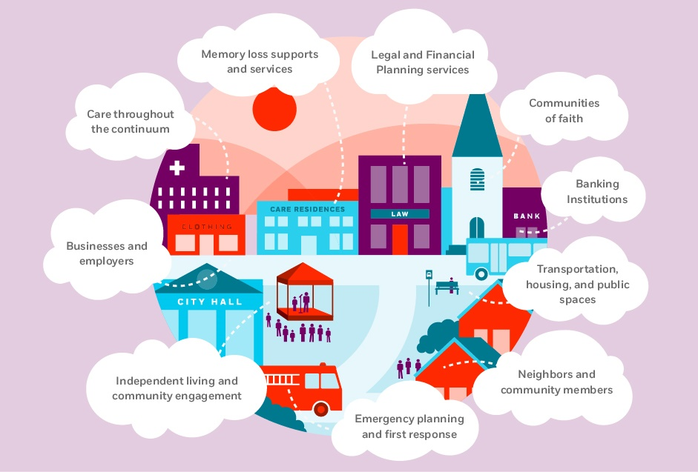
Response to the Need

Slide 9
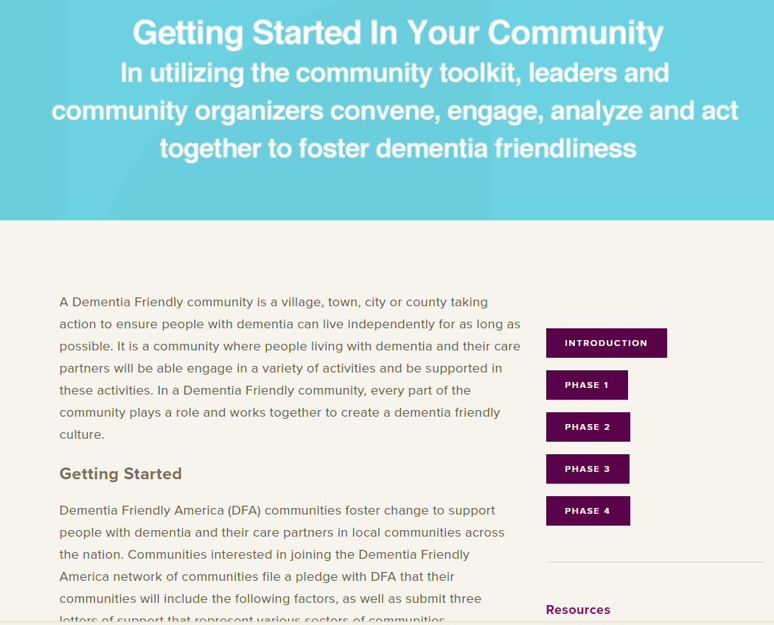
DFA Online Resources: Community Toolkit, Sector Guides, Resources
www.dfamerica.org

Slide 10
Community Toolkit Steps
Convene key community leaders and members to understand dementia and its implications for your community. Then, form an Action Team.
Engage key leaders to assess current strengths and gaps in your community
Analyze your community needs and determine the issues stakeholders are motivated to act on; then set community goals.
ACT together to implement and identify ways to measure progress.

Slide 11
Convene
KEY STEPS
Enlist Champions
Discuss Readiness Build an Action Team
Coordinate the Team and Develop Timelines
Build the Case
DFA RESOURCES:
Team Meeting Discussion Guide
Dementia Friendly Community Overview – PowerPoint
Call to Action: Email or Letter Invitation Template
Interest in Dementia Action Team Sign-up Sheet
Meeting Agenda and Minutes template
Budget Template
Grant Request Template
Community Coordinator Job Description
Action Team Workplan Template
Action Team Roster

Slide 12
Engage
KEY STEPS
Form a sub-team or use Action Team to drive the assessment effort.
Develop/ revise the Community Assessment tool and process.
Conduct the community assessment (such as surveys and/or focus groups)
DFA RESOURCES:
Sector-based Questionnaires
Community Resource Flyer Template
Dementia Friendly America Overview
Demographics of Dementia in Your Community
DFA Sector Guides
Master List of Interview Contacts
Pre-Interview Email
Community Call Script
Interviewee Thank You Letter
DFA Sector Guides

Slide 13
Analyze
KEY STEPS
Compile and interpret the data
Identify dementia friendly priorities for your community
DFA RESOURCES
Community Engagement Tool Instructions
Community Engagement Tool
Referrals Worksheet
Key Element Question Matrices
Using the Matrices Video (ACT on Alzheimer's)
Engagement Priority Rating Spreadsheet

Slide 14
Act
KEY STEPS
Share the Results and Involve the Community
Create and Implement a Community Action Plan
Communicate Progress and Next Steps
Assess and Adjust
DFA RESOURCES
Community Meeting - Prioritizing Goals Process
Prioritizing Community Goals Video (ACT on Alzheimer's)
Workplan Template
Dementia Friendly Metrics
Action Plan Options Menu
Communications Template
Budget template
Grant request template
Examples of Action Plans: ACT on Alzheimer's Community Booklet
Sample Work Plan

Slide 15
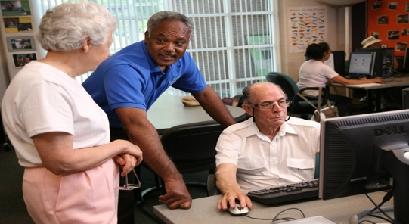
Sample Community Actions
Offering training to faith communities
Collaborating with law enforcement on training, ID bracelet, or file of life initiatives
Work with local hospitals/ physicians to promote early diagnosis and connection to community resources

Slide 16
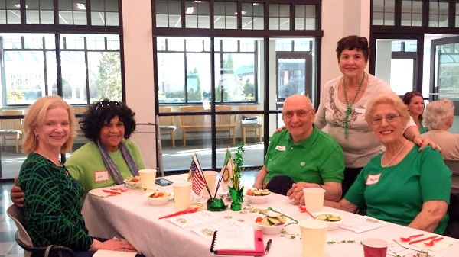
Sample Community Actions
Identifying partners for hosting memory cafes
Develop a dementia friendly business initiative
Working with local restaurant(s) for dementia friendly dinners once a month

Slide 17
Alignment with Age-Friendly
Our website includes sector guides, provider tools, a community toolkit and other guidance for communities working towards becoming dementia friendly.

Slide 18
Dementia Friendly America (DFA) Network
Joining DFA means community is working to become more dementia friendly:
Community approach (involving at least 3 sectors of community
Including people with dementia and their care partners in planning
Adopting dementia friendly practices and goals
Joining Network
Memo and three letter of support

Slide 19
How We Support Communities
Website materials are free, downloadable, customizable
Webinars for DFA communities
Access to DFA communities listserv
Technical assistance with DFA staff team
Access to DFA logo / branding
Ability to connect with other DFA communities
Opportunities to have your work highlighted

Slide 20
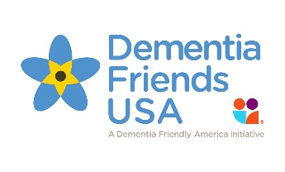
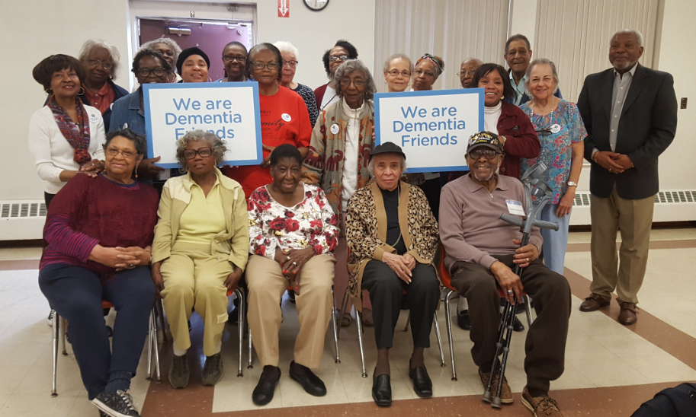
Dementia Friends USA
www.dementiafriendsusa.org

Slide 21
Dementia Friends USA
Dementia Friends USA is part of a global social awareness movement
By helping everyone in a community understand what dementia is and how it affects people, each of us can make a difference for people touched by dementia.

Slide 22
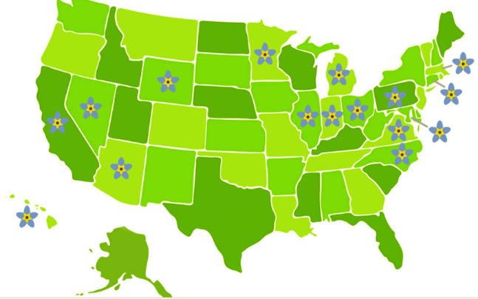
Key Concepts
Online and in-person Dementia Friends sessions
In-person sessions are in: Arizona, California, Connecticut, Hawaii, Illinois, Indiana, Maryland, Massachusetts, Michigan, Minnesota, Pennsylvania, Nevada, North Carolina, Ohio, Pennsylvania, Virginia, Washington, Wisconsin

Slide 23
Contact Us
www.dfamerica.org
www.dementiafriendsusa.org
info@dfamerica.org

