Slide 1
Dementia Friendly Airports First Responder Self-study Program for Airport Police Departments Developed by Dementia Friendly Tulsa A Member of the Dementia Friendly America Network

Slide 2
Contents: Two Sections
Section one –
23 slides about becoming dementia friendly, Alzheimer’s facts, and tips for communicating with a person who has dementia
Section two –
A link to the Alzheimer’s Association’s free, online First Responder Training providing scenarios - including wandering, driving, shoplifting and abuse/neglect – and associated quizzes
Upon completion, you’ll receive a Certificate of Completion
Your entire time commitment
should be one hour or less.

Slide 3
Section 1: Here’s What You’ll Learn
Dementia Friendly America Overview
About Dementia-friendly Communities and Organizations
Why be Dementia Friendly?
Alzheimer’s and Dementia Information, Statistics and
Warning Signs
Six Communication Tips
Reducing Your Risk

Slide 4
Dementia Friendly America
Dementia Friendly America is a national network of communities, organizations and individuals seeking to ensure that communities across the U.S. are equipped to support people living with dementia and their caregivers.

Slide 5
Dementia-friendly Communities & Organizations
Dementia-friendly communities foster the ability of people living with dementia to remain in community
and engage and thrive in day-to-day living.
Announced in 2015 at the White House Conference on Aging
Educational programs are free; volunteer-driven
Successful in the global community as well as the U.S.
Provides awareness of how to assist in positive ways that promote kindness and safety
Helps reduce fear and stigma associated with having dementia/Alzheimer’s

Slide 6
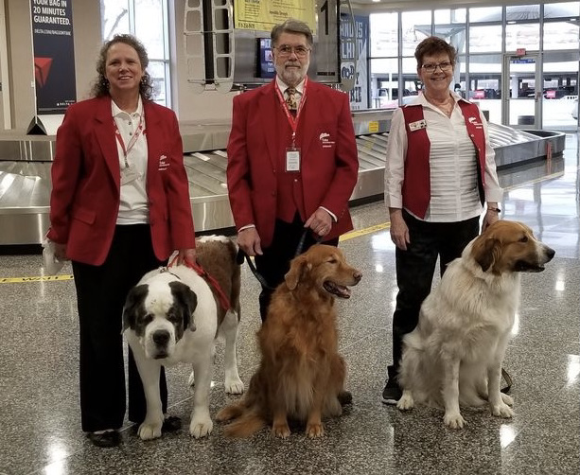
Program Objectives
Increases community involvement
Provides awareness, kindness and safety
Enhances quality of life for those with dementia
Builds bridges with community resources
Helps reduce fear and stigma
More willing to seek diagnosis
More advanced planning for care/finances
Fraud and abuse are reduced

Slide 7
Why Should You Be Dementia Friendly?
This community has a growing number of citizens with dementia or cognitive decline.
U.S. Census statistics tell us:
By 2035, people age 65 and older will
outnumber those under age 18
Baby boomers are increasing
The first wave, born in 1946, turned 65 in 2011
The last wave, born in 1964, turns 85 in 2049
The number of people prime for dementia may be significant for the next 30-plus years.

Slide 8
Without Proper Information Some People …
Avoid interacting with those who have dementia
Become resentful because of the extra time that those living with
dementia may require
Are embarrassed by the behavior some with cognitive decline may
exhibit
Changing our attitudes and building knowledge
about dementia enables us to better share daily life experiences with those living with dementia, and their family members.

Slide 9
Why Should Airports Care?
A diagnosis of dementia does not mean a person
stops traveling.
Travel is beneficial for those living with dementia and
their partners.
The extra stimulation in airports, though, can
create anxiety.
Travel companions are impacted, too.

Slide 10
Airport Travel Concerns
Overall anxiety
Getting lost or separated – particularly at security
Understanding announcements
Understanding signage
Finding a family assist restroom
Navigating/walking through the terminal
Moving walkways
Finding a quiet place to get away from crowds and noise
Primary Airport Challenges
Other Areas of Frustration
Source: Innovation in Aging 2020

Slide 11
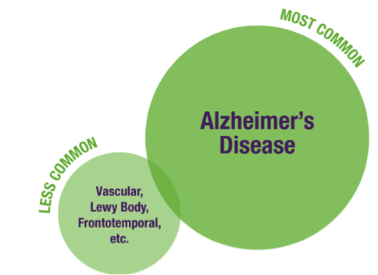
Dementia is NOT a Normal Part of Aging
Dementia Characteristics: difficulties with cognitive skills affecting one’s ability to perform everyday activities.
50 million
PEOPLE WORLDWIDE
HAVE DEMENTIA
⬅60-80%
NOTE: Other causes can mimic dementia symptoms – depression, side effects from meds, thyroid problems, infection – so a doctor’s diagnosis is important.
Sources: 2021 Alzheimer’s Disease Facts and Figures
Sep 2020 ADI World Alzheimer Report 2020

Slide 12
1 in 9 people age 65+ have Alzheimer’s dementia
Two-thirds are women
Blacks are 2 times as likely as whites to have Alzheimer’s
Hispanics are 1.5 times as likely as whites to have Alzheimer’s
Health and healthcare disparities also impact Native American and Asian populations
More than 6 million over age 65 have Alzheimer’s dementia
200,000 individuals, some as young
as age 30, have younger-onset
Alzheimer’s – it’s not just an
“old person’s disease”
Alzheimer’s in the United States
Source: 2021 Alzheimer’s Disease Facts and Figures

Slide 13
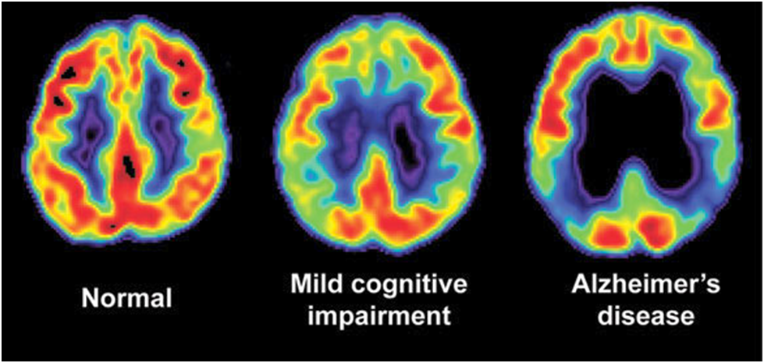
Alzheimer’s is a Progressive Disease
Progression from mild impairment
to final stages can take 4-to-20 years.
This means that those in the early-to-middle stages are able to
shop, participate, worship, travel, play, handle business transactions,
and enjoy fairly full social lives for much longer than society acknowledges.
Dementia Friendly America focuses on helping people in early-to-mid stages stay engaged in the community for as long as is possible.

Slide 14
Alzheimer’s is America’s Most Costly Disease
Unless there is a medical breakthrough…
In 2050, the number of those 65 & older in the U.S.
with Alzheimer’s is projected to be almost 13 million
Alzheimer’s care costs in 2050 could rise to $1.1 trillion from $355 billion in 2021.
Source: 2021 Alzheimer’s Disease Facts and Figures

Slide 15
Did You Know the Entire Family is Affected? 83% of Caregivers are Unpaid Family or Friends
25% of that group also is part of the sandwich generation: working fulltime while also caring for kids AND parents or other adults
Caring for family members with dementia is so demanding and stressful:
57% go to work late, leave early or need extra time off
18% leave fulltime careers for part-time jobs;
9% ultimately quit working.
An overall average of about two people provide care for a person with Alzheimer’s or other dementia.
Source: 2021 Alzheimer’s Disease Facts and Figures

Slide 16
10 Signs of Alzheimer’s Disease
1. Memory loss that disrupts daily life
2. Challenges in planning or solving problems
3. Difficulty completing familiar tasks at home, work or leisure
4. Confusion with time or place
5. Trouble understanding visual images and spatial relationships
6. New problems with words in speaking or writing
7. Misplacing things and losing the ability to retrace steps
8. Decreased or poor judgment
9. Withdrawal from work or social activities
10. Changes in mood and personality
Source: Alzheimer’s Association

Slide 17
Alzheimer’s vs. Typical Age-related Changes
Don’t immediately assume memory issues are dementia!
Alzheimer’s/Dementia Warning Signs
Poor judgment/decision making
Inability to manage a budget
Losing track of the date or season
Difficulty having a conversation
Misplacing things and being unable to retrace steps to find them
Typical Aging Memory Issues
Making a bad decision once in a while
Missing a monthly payment
Forgetting the date/season; remembering it later
Sometimes forgetting which word to use
Losing things from time-to-time
Source: Alzheimer’s Association

Slide 18
Important Note:
THIS PROGRAM IS
all about being kind, patient, and
promoting safety for all involved.
It is not intended to be a means to diagnose or describe someone as having dementia.

Slide 19
Communication Techniques are Key
Tone of voice and body language
become very important when communicating with those
who have dementia.
What you say and
how you say it is critical.

Slide 20
Six Communication Tips
Approach the person from the front
This may reduce fear and keep the person from being startled
People with dementia often lose peripheral vision
Introduce yourself by name; use the person’s name if you know it
Speak clearly and be patient
The person may hear your words but have trouble interpreting them
Try different words; use short, simple sentences
Avoid complicated, direct questions; keep choices to a minimum
Don’t raise your voice
Try to have the conversation where there are limited distractions

Slide 21
Six Communication Tips, cont.
Listen closely
If the person says something confusing or even wrong, don’t argue or correct
If the person struggles for a word, suggest one – but don’t finish the sentence
Try to not rush the conversation
Smile and make eye contact
Someone with dementia may have trouble understanding
what you are saying, but may quickly interpret the look
on your face, tone of voice, and body language
Respect the person’s space

Slide 22
Six Communication Tips, cont.
Respond to a look of distress
The person may be overwhelmed by too many people or too much noise, so
give her or him time to collect thoughts
Visual issues caused by incorrect brain signals may be causing problems
Lack of depth perception can make floor transitions
or shadowed areas look like deep holes
Mirrors and reflective surfaces may cause disorientation;
those with Alzheimer’s often visualize themselves as they looked when younger –
they may think the person in the reflection is a stranger

Slide 23
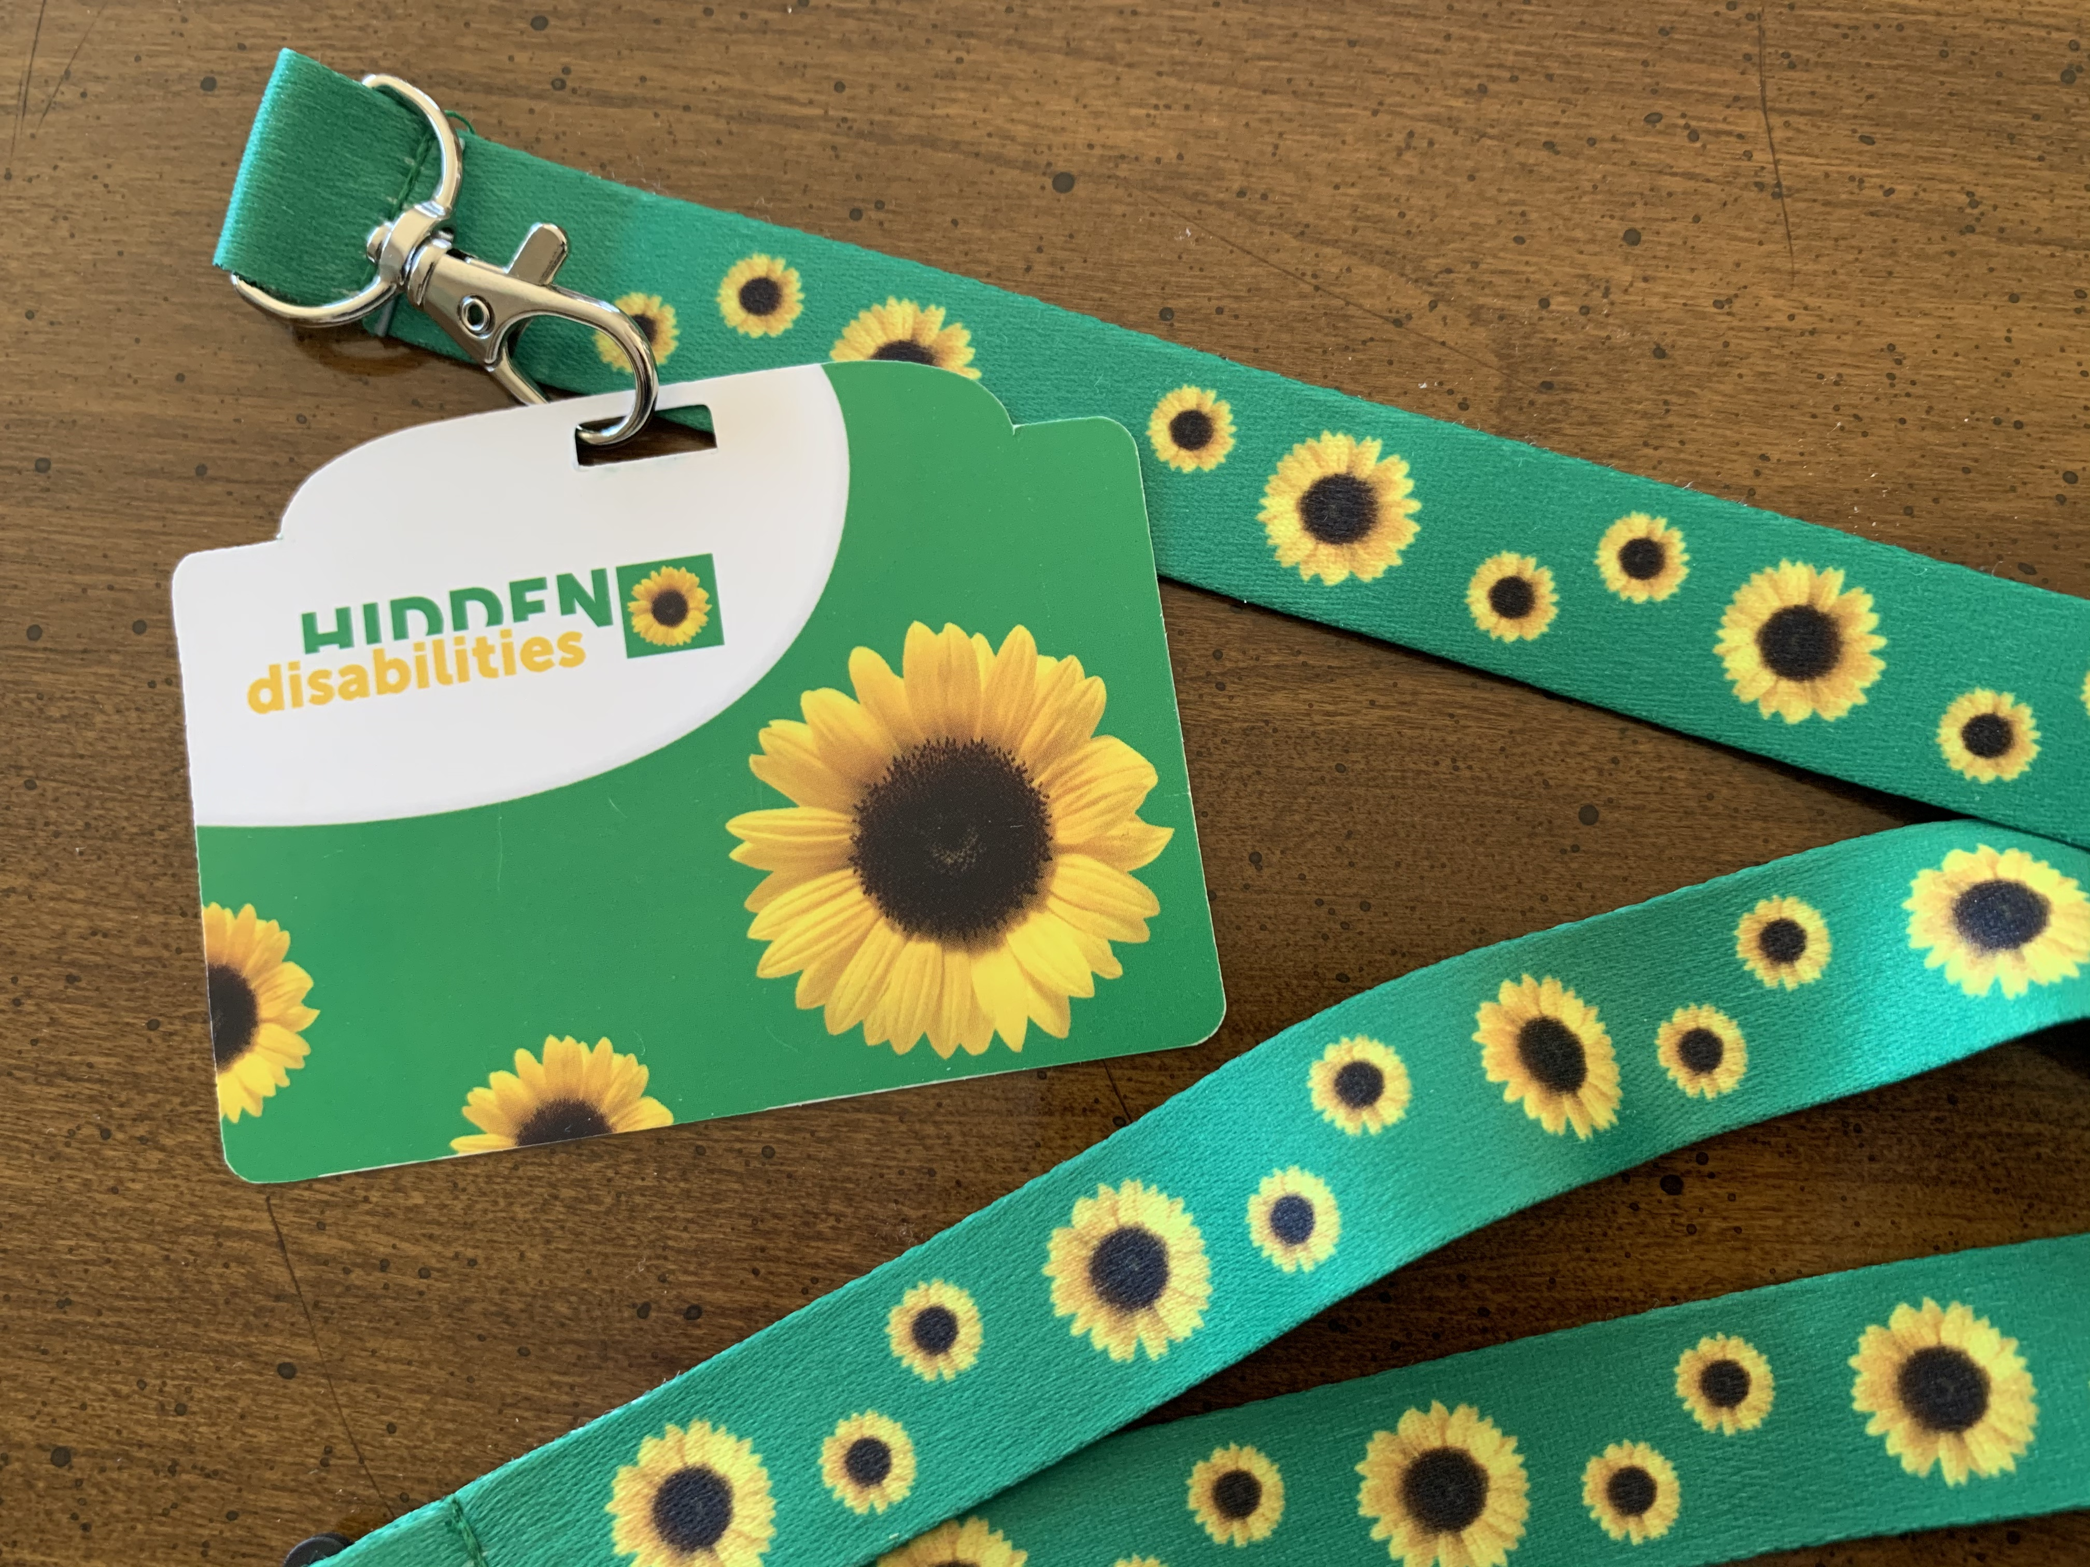
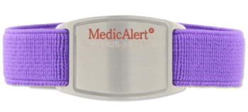
Six Communication Tips, cont.
Respond to a look of distress, cont.
If the person is lost, try to determine if he or she is alone
or has just become separated from a companion –
you may just need to help them reunite
See if the person is wearing a Sunflower Lanyard, MedicAlert® or Alzheimer’s
Safe Return® bracelet
Don’t leave the person alone – stay until help arrives

Slide 24
Six Communication Tips, cont.
Watch for Signs of Change
Be aware AND RESPOND accordingly
For some people with dementia, what they can or cannot
do may change on a daily basis
If you reflect back to the 10 Warning Signs of Alzheimer’s, you will note that
“change” is a common theme
So, be observant and step forward to help when needed

Slide 25
Reduce Your Dementia Risk
Be physically active
Maximize education
Quit smoking
Follow a heart-healthy lifestyle
Maintain healthy weight
Seek treatment for depression
Stay socially engaged
Get treatment for high blood pressure
Have hearing loss treated
Protect your head and brain

Slide 26
Section 2: Scenarios and Certificate Request
You’re almost finished!
In Section 2, you’ll view the Alzheimer’s Association’s free, online First Responder Training videos. They include situations you are likely to experience and provide associated information and quizzes regarding how to handle these encounters.
Then, you’ll be directed to a page
where you can print and/or save
your Certificate of Completion.
Go to the next slide for the link.

Slide 27
Viewing the Scenarios and Printing Your Completion Certificate
Go to this link:
https://training.alz.org/products/4021/approaching-alzheimers-first-responder-training?_ga=2.259100035.86842223.1569370663-452561694.1519663229&_gac=1.2756356.1568128256.EAIaIQobChMIu4rn88PG5AIVBKzICh0NzAR5EAEYASAAEgId6fD_BwE
Click on the purple “Add to Cart” button (this is free)
Log in following the instructions to create a new account
(This allows you to access the training and to print/save your Certificate of Completion.)
Go through the briefing (overview) and the five scenarios,
and complete all the quizzes. Follow the instructions to
print your certificate.
Your certificate will be emailed to you
Thank you for helping our city and all of its first responders become dementia friendly. Your service to our airport is greatly appreciated!

Slide 28
Dementia Friendly America DFAmerica.org
Developed by Dementia Friendly Tulsa - A Member of the Dementia Friendly America Network (April 2021)
Some content adapted from ACT on Alzheimer’s® developed tools and resources.
Thank you to the Alzheimer’s Association for its First Responder Training link.

