Slide 1
Dementia Friendly awareness for faith communities
Presenter Information
Presentation Date
Notes:
Good morning and thank you for inviting me to ______ to offer this Dementia Friendly Faith Communities training. Introduce yourself and share your connection to Alzheimer’s and other ADRDs. You may wish to poll the audience for others who know someone with/or is a caregiver for (past or present) someone with the disease.
Mention: This training is made possible by the Agency on Aging, through an Alzheimer’s Disease Supportive Services Grant (ADSSP) provided by the Illinois Dpt on Aging (IDoA) through the Administration on Community Living (ACL).

Slide 2
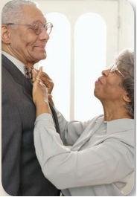
Objectives
Introduce Dementia Friendly Community concept
Define dementia
Present dementia facts & statistics
Identify signs and symptoms of dementia
Outline and discuss positive approach and communication strategies
Present & discuss dementia-friendly strategies for Faith Communities
List and describe physical characteristics of Dementia-Friendly Environments
Outline and practice process of becoming a Dementia Friend
Notes:
Objectives
Introduce Dementia Friendly Community concept
Define dementia
Present dementia facts & statistics
Identify dementia signs & symptoms
Outline and discuss positive approach and communication strategies
Present dementia-friendly healthcare practice strategies
List and describe physical characteristics of Dementia-Friendly Environments
Outline process of becoming a Dementia Friend
And then I will provide a Case Study where you can offer your ideas if you were to encounter a similar situation.

Slide 3
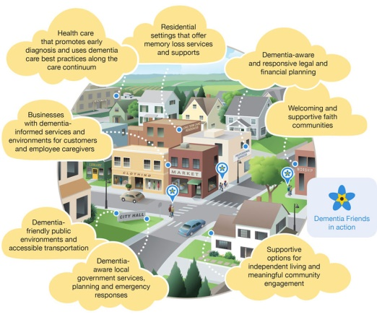
Dementia Friendly Communities
Are characterized by
An understanding of dementia
Less fear and avoidance
Inclusion and support for people living with dementia and their families
Concerted efforts to raise awareness about dementia, transform attitudes, and move people to action
Improved quality of life for persons with dementia, their family members, and friends
(Dementia Friends USA, 2018)
Notes:
Dementia Friendly Communities are characterized by
An understanding of dementia
Less fear and avoidance
Inclusion and support for people living with dementia and their families
Concerted efforts to raise awareness about dementia, transform attitudes, and move people to action
Improved quality of life for persons with dementia, their family members, and friends

Slide 4
Notes:
Dementia Friendly communities take an all sector approach. As you can see on this slide, Dementia friendly faith communities are warm and welcoming, first responders are on the front-line… healthcare promotes early diagnosis, dementia friendly public environments, accessible transportation and banking and legal services that can identify people with memory loss that may be prime targets for financial exploitation and abuse.

Slide 5
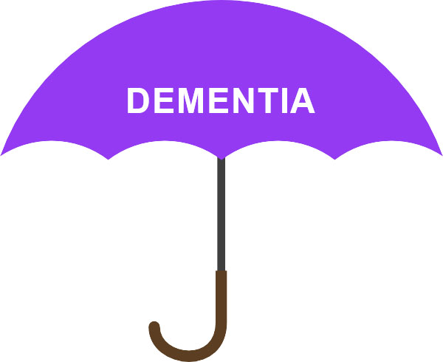
Dementia
Dementia describes loss of
Memory,
Thinking, and
Communication abilities that
Interfere with the ability to do daily tasks.
(Dementia Friends USA, 2018)
Notes:
What is dementia? Dementia describes loss of
memory
thinking, and
social abilities that
interfere with the ability to do daily tasks.

Slide 6
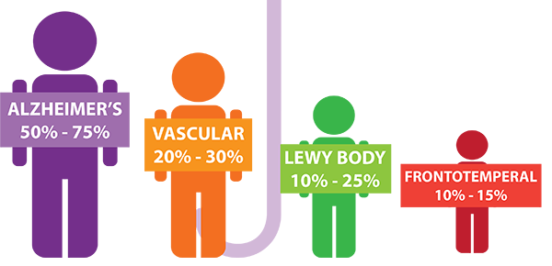
Dementia Facts and Stats
Dementia is not a normal part of aging… though the vast majority of persons with dementia are 65 or older.
Dementia is caused by brain disease and brain damage.
4 major disorders
(Dementia Friends USA, 2018)
Notes:
The major symptom of Alzheimer’s disease is memory loss; rarely, but some people in their 30s have “early onset” Alzheimer’s.
The major symptom of vascular dementia is problem solving challenges.
The major symptom of Lewy body dementia is variability… day-to-day and within a day. It is related to Parkinson’s disease.
The major symptom of frontotemporal dementia is behavior issues with people doing things that are very “out of character.” FTD strikes younger populations, generally 40-60.

Slide 7
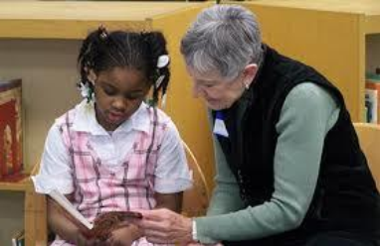
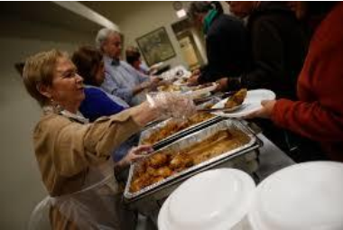
Dementia Facts and Stats
1in 7 adults age 65+ has dementia; 1 in 9 age 65+ has Alzheimer’s disease.
Dementia is more than a memory issue.
A person with dementia can still enjoy a good quality of life.
Dementia does not diminish a person’s value to the community.
(Alzheimer’s Assoc., 2018; Dementia Friends USA, 2018; Interfaith Older Adult Programs, n.d.)
Notes:
1in 7 adults age 65+ has dementia; 1 in 9 age 65+ has Alzheimer’s disease.
Dementia is more than a memory issue.
A person with dementia can still enjoy a good quality of life.
Dementia does not diminish a person’s value to the community.
Pictures are from Interfaith Older Adults Program in Milwaukee; these volunteers have dementia.

Slide 8
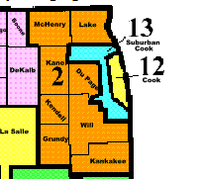
Agency on Aging: Dementia
As of July 2016, over 654,000 adults age 60+ years live in NEIL’s 8-county planning and service area.
Based on pro-rated estimates of data provided by the U.S. Census and the Alzheimer’s Association…
Over 58,000 people have Alzheimer’s disease ONLY.
An additional 16,000+ people have another form of dementia.
Over 156,000 people care for a person with Alzheimer’s disease or other dementia.
(Alzheimer’s Association, 2018; AAA-NEIL, 2018, U.S. Census, 2017)
Notes:
NEIL: Alzheimer’s Disease & Family Caregivers
As of July 2016, over 654,000 adults age 60+ years live in NEIL’s 8-county planning and service area.
27.5% are age 75 or older
Based on pro-rated estimates of data provided by the U.S. Census and the Alzheimer’s Association…
Over 58,000 people have Alzheimer’s disease ONLY. Does not include those suffering from MCI.
Over 156,000 people care for a person with Alzheimer’s disease or other dementia.

Slide 9
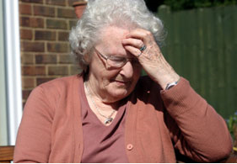
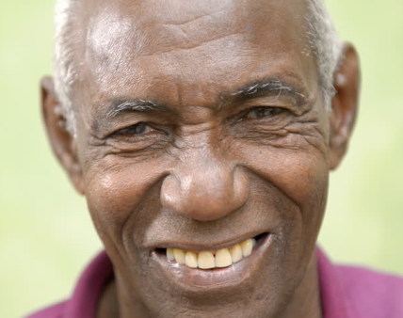
Dementia Signs & Symptoms
Communication difficulties
Becoming lost
Losing things
Frustration
Repetition
Decreased or poor judgment
Unacceptable behavior
Confusion with time and/or place
(Dementia Friendly America, 2018)
Notes:
Ask participants to name “challenges” before displaying list.
Dementia Signs & Symptoms
Communication difficulties
Becoming lost
Losing things
Frustration
Repetition
Decreased or poor judgment
Unacceptable behavior
Confusion with time and/or place

Slide 10
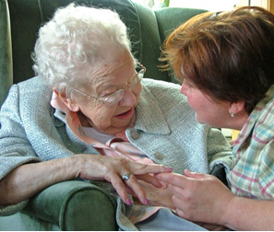
Approach & Communication Strategies
Treat the person with dignity and respect.
Avoid talking “past” the person.
Be patient and supportive.
Let the person know you are listening and try to understand.
Avoid criticizing or correcting.
Offer comfort and reassurance.
If communication is difficult, reassure & encourage the person to continue.
(Dementia Friendly America, n.d.)
Notes:
Discuss point by point. If able: Follow up with video ( Dementia Friends USA website link).
Approach & Communication Strategies
Treat the person with dignity and respect.
Avoid talking “past” the person.
Be patient and supportive.
Let the person know you are listening and try to understand.
Avoid criticizing or correcting.
Offer comfort and reassurance.
If communication is difficult, reassure & encourage the person to continue.

Slide 11
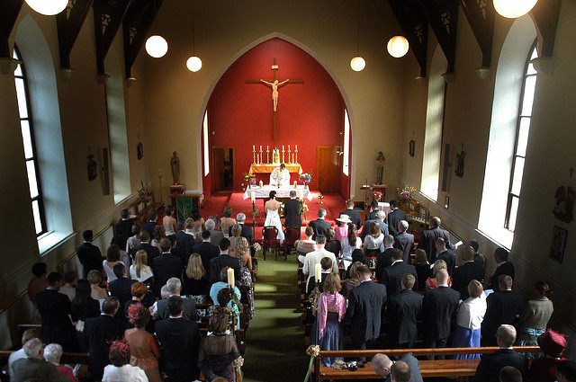
Respond by Educating the Faith Community
Invite a person with dementia or care partner to give a talk about their experience.
Provide congregants with ideas of ways to support families:
Help people with dementia feel loved, valued, and a sense of belonging.
Spend one-on-one time with the person with dementia.
Assist with transportation.
Help the family worship at home.
Offer a volunteer companion.
Provide ongoing prayer support.
Offer training to volunteers.
(Dementia Friendly America, 2017)
Notes:
Tie the notion of “love, value, and sense of belonging” with the ways that we create this climate for everyone.
Invite a person with dementia or care partner to give a talk about their experience.
Provide congregants with ideas of ways to support families:
Help people with dementia feel loved, valued, and a sense of belonging.
Spend one-on-one time with the person with dementia.
Assist with transportation.
Help the family worship at home.
Offer a volunteer companion.
Provide ongoing prayer support.
Offer training to volunteers.

Slide 12
Respond with Dementia Friendly Practices
Wear name tags.
Provide a quiet area when the person may go if needed.
Display signs that clearly ID restrooms & exits.
Plan spiritual visits that include the traditional & familiar.
Recognize the spiritual significance of nature.
Organize meaningful activities that engage the senses.
Link the person with dementia with empathetic support.
Be attune to the individual’s spiritual needs and beliefs.
(Dementia Friendly America, 2017)
Notes:
Points 1-3 are environmental.
Points 4-6 focus on engagement.
Points 7-8 focus on the person as an individual.

Slide 13
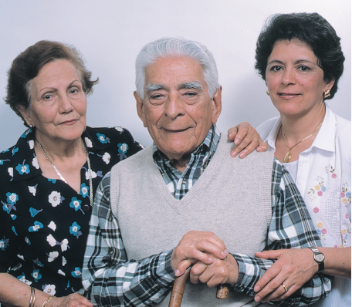
Respond to Care Partners/Families
Recognize signs of care partner stress and direct partner/ family to appropriate resources.
Encourage care partners to care for themselves.
Offer support frequently.
If care partners cannot attend services, take services and rituals to them.
Encourage care partners to take advantage of respite.
Form a memory café or a care partner support group.
(Dementia Friendly America, 2017)
Notes:
For every person with dementia, 10-12 others are affected.
Though children and persons with dementia often get along very well together, caring for a person with dementia can diminish time spent with parents, vacations, and “fun” events.
Care partners often don’t want to admit that they need help.
Spirituality is important to many caregivers.
Suggest respite resources. Refer to the county specific Caregiver Resource Center and Caregiver Counseling Center
Explain memory cafes: A Memory Cafe is a safe and comfortable space where caregivers and their loved ones can socialize, listen to music, play games, and enjoy other appropriate activities. They provide mutual support and exchange information. They can simply enjoy the company of those with similar things in common.

Slide 14
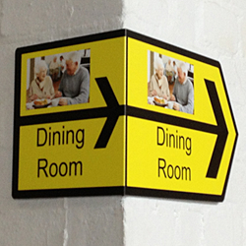
Dementia Friendly Environments
Signage and Navigation Tips
Use simple and easy-to-read signs; black on white/yellow.
Place signs at eye-level and at major decision points.
Lighting: Provide plentiful, natural lighting. Avoid glare and shadows.
Flooring: Avoid reflection, slippery surfaces, and uneven flooring.
Seating: Provide quiet waiting areas that offer recognizable places to sit, e.g., chairs, benches.
(Adapted from Dementia Action Alliance, n.d.)
Notes:
Remind participants that the majority of older adults are older and may have vision, hearing, and mobility issues as well. Discussion will vary depending on client needs in the specific environment.
Signage and Navigation Tips
Use simple and easy-to-read signs; black on white/yellow.
Place signs at eye-level and at major decision points.
Lighting: Provide plentiful, natural lighting. Avoid glare and shadows.
Flooring: Avoid reflection, slippery surfaces, and uneven flooring.
Seating: Provide quiet waiting areas that offer recognizable places to sit, e.g., chairs, benches.

Slide 15
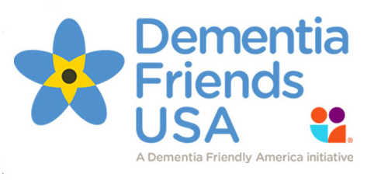
Being a Dementia Friend
Work with other community members to support people with dementia, their family members, and friends by
raising awareness and reducing stigma,
encouraging the adoption of dementia friendly practices, and
providing training and education on how to effectively interact with people living with dementia.
(Dementia Friends USA, 2018)
Notes:
Summary.
Work with other community members to support people with dementia, their family members, and friends by
raising awareness and reducing stigma,
encouraging the adoption of dementia friendly practices, and
providing training and education on how to effectively interact with people living with dementia.

Slide 16
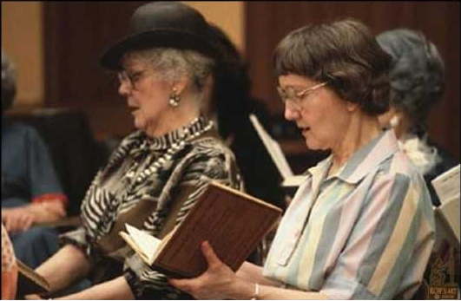
What could you do?
A long-time congregation family has mentioned memory changes with their mother. One week the family group attends a service. In the middle of the service, the mother stands up and wants to leave. She is very vocal about needing to leave, gets out of the pew, and loudly walks out.
How can you support her and the family?
What can you do right away to be sure she is safe?
Notes:
A long-time congregation family has mentioned memory changes with their mother. One week the family group attends a service. In the middle of the service, the mother stands up and wants to leave. She is very vocal about needing to leave, gets out of the pew, and loudly walks out.
How can you support her and the family?
What can you do right away to be sure she is safe?
Allow time for audience participation…
You can also remind of previously learned communication strategies.
(Treat the person with dignity and respect.
Avoid talking “past” the person.
Be patient and supportive.
Let the person know you are listening and try to understand.
Avoid criticizing or correcting.
Offer comfort and reassurance.
If communication is difficult, reassure & encourage the person to continue).

Slide 17
For Additional Information…
Contact
Colette Jordan
Northeastern Illinois Area Agency on Aging
630-293-5990
cjordan@ageguide.org
Notes:
Change contact information as appropriate.
Lastly, Explain the purple angel: Look for the purple angel where you worship, shop/eat/bank. Anywhere you do business. The Purple Angel symbolizes a guardian over those living with dementia, their families and friends, and those helping to raise awareness of the disease.
Questions?

Slide 18
Resources
Alzheimer’s Association. (2018). 2018 Alzheimer’s Disease Facts and Figures. Retrieved from https://www.alz.org/media/HomeOffice/Facts%20and%20Figures/facts-and-figures.pdf.
Dementia Action Alliance. (n.d.) Dementia friendly physical environments checklist. Retrieved from https://www.dementiaaction.org.uk/assets/0000/4336/dementia_friendly_environments_checklist.pdf.
Dementia Friendly America [DFA]. (2018a). Sector guide: Neighbors and community members. Retrieved from https://bit.ly/2MrSDiA
Dementia Friendly America [DFA]. (2018b). Case studies. Retrieved from https://bit.ly/2FXqe2H
Dementia Friendly America. (2017). Faith communities. Retrieved from https://bit.ly/2kXhDDz
Dementia Friends USA. (n.d.). Dementia Friends USA Overview. Retrieved from https://dementiafriendsusa.org/become-a-dementia-friend
Dementia Friends USA. (2018a). What is a dementia friendly community? Retrieved from https://dementiafriendsusa.org/what-dementia-friendly-community
Dementia Friends USA. (2018b). What is dementia? Retrieved from https://dementiafriendsusa.org/what-dementia
Interfaith Older Adults Program. (n.d.). Supporting volunteer opportunities for those with dementia: An intrical [sic] part of designing dementia friendly communities. Retrieved from https://bit.ly/2qxY4Co
U.S. Census Bureau. (2017). Quick facts Illinois. Retrieved from https://www.census.gov/quickfacts/il.

